Slide 1
Quantifying the Economic Impacts of Community Events
Steven R. Miller, Ph.D.
Director: Center for Economic Analysis
Michigan Association of Fairs and Exhibitions
133nd Annual Convention
January 11-13, 2018
Grand Rapids, MI

Slide 2
What are Community Events
Conferences/Conventions | Trade/Specialty Shows
Arts Fairs | Carnivals and Festivals
Concerts | Home and Garden Shows
County Fairs | Sporting Events/Tournaments
Runs/Marathons | Charity Events
Any non-continuous event that may draw in outside visitors to the community, or entice local residents to remain in the area that would otherwise visit other communities.

Slide 3
How Events Impact Communities
Builds social cohesion
Placemaking
Enhances tourism visibility and outside visitation
Generates economic activity
All such impacts can be measured, but we will focus on the nature and requirements for undertaking economic impact measurements.

Slide 4
Public Budget Concerns
Increasing pressure to justify public investments
NGOs and sponsors want to know their investments are impactful
Sound evaluation can be instrumental in getting public buy-in
Is it worth the effort and the costs?
  Economic impact evaluations of community events are commonly found today

Slide 5
Economics of Events
The expenditures arising from events give rise to measurable economic impacts
  Revenues do not equal expenditures
  Patron expenditures count only if they capture new expenditures that would not have taken place in the absence of the event
  The costs (expenditures) in hosting the event should not be overlooked
Notes:
Revenues: Vendor from Toledo sells $1,000 in art? Revenues only lead to an economic impact if spent in the local economy.
Annual Fair surpluses used to maintain facilities
Vendor sales revenues spent in local economy
Patron: if local, they supplant other uses of those funds spent at event. If visiting, all leads to impact.
Costs: if spent from existing funds, no impact: if spent from ticket sales, only share that is from out of state. If funding from grant: all leads to impact
Should be directly attributable to the event
Would not have occurred without the event
Should exclude expenditures that would have taken place in the absence of the event
Should represent new economic activity created in the community

Slide 6
Economics of Events
Expenditures that leave the community
Expenditures that lead to economic impacts are smaller than total event expenditures
  Total Expenditures include expenditures that do not enhance total economic activity in the community
  Expenditures that increase total economic activities are infusions into and remain in the local economy to be re-spent
Impactful Expenditures
Total Expenditures
Expenditures that increase total economic activities
Expenditures that supplant existing expenditure

Slide 7

Economics of Events
Basis for measuring impacts…
  Local expenditures from funding, coming from outside the community, to host event
  Local expenditures from non-local visitors because of the event
  Local expenditures of local residents who would have otherwise left for other recreational opportunities in the
  absence of the event
Notes:
What is common is that money is added to or retained in the local economy,

Slide 8
Economics of Events
The Golden Rule of Measuring Impacts!
Hence…
…economic impacts arise from new expenditures that take place in the local economy and stays in the local economy and would not take place in the absence of the event

Slide 9
Impact-forming
Direct Expenditures
  Host expenditures in preparation and in hosting the event
    Facilities rentals, advertisement…
  Patron expenditures while at event and/or within the event’s host community
    Food purchases, lodging, more food purchases…
  Vendor expenditures while at event or within the event’s host community
    Food purchases, lodging, space rental…

Slide 10
Impact-forming
Direct Expenditures
Host Expenditures
  Renting fees for equipment
  Location fees – if appropriate
  Local bands or entertainment
    Public/sponsored expenditures for hosting the event should be captured if purchased from a local provider
    Source of funding may moderate expenditure estimates
  Record expenditures by category
Notes:
If spending on event means spending less elsewhere, then only net expenditures
If spending from revenues, only spending from revenues from outside visitors give rise to an impact

Slide 11
Impact-forming
Direct Expenditures
Patron Expenditures
  Requires two parts
    Expenditure profiles of average visitor or party
    Number of parties
  Do this for both local and outside visitors
    Total expenditures is estimated as average party expenditure times number of parties

Slide 12
Impact-forming
Direct Expenditures
Patron Expenditure Profiles
  On-site Intercepts
    Randomly select visitors/parties to interview
    Ask
      Where from (if local, whether they stayed because of event)?
      Number of visitors in party
      How much spent (expected to spend) on various categories?
      Type of overnight stay (and count of nights if the event spans multiple days)
      How much spent outside venue

Slide 13
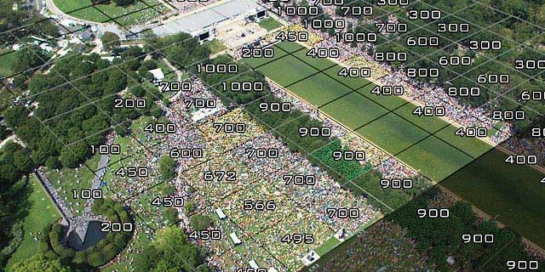
Impact-forming
Direct Expenditures
Patron Party Counts
  Gated event – Ticket Sales
  Open event – Triangulate
    Parking spots used
    Random count estimates at different times of the day
    Jacobs Method to measuring crowd size (area times density)

Slide 14
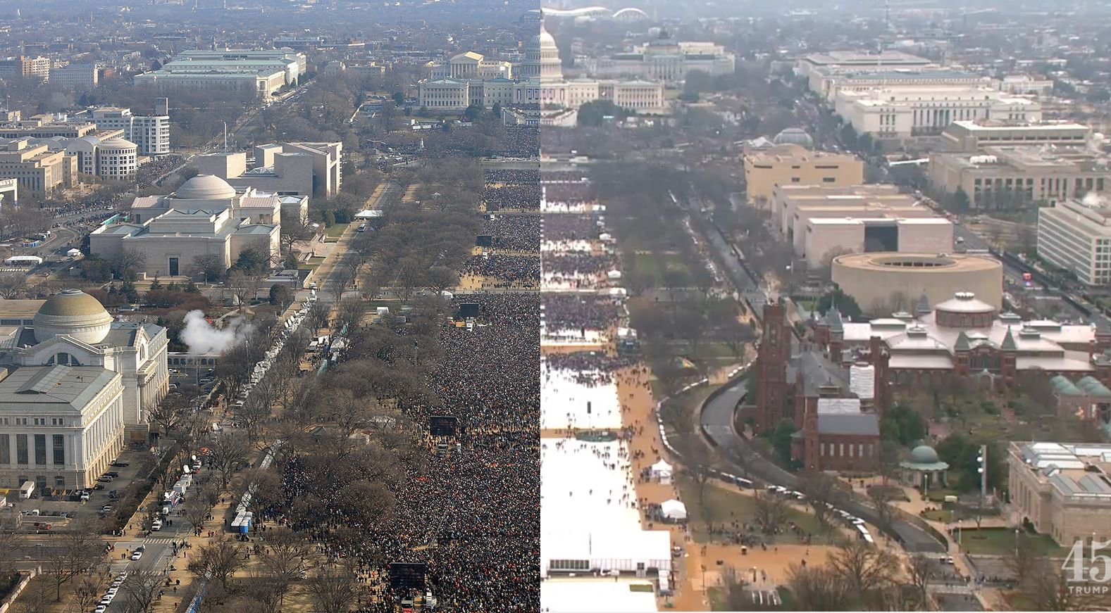
Don’t be like Trump

Slide 15
Impact-forming
Direct Expenditures
Vendor Expenditures
  Requires two parts
    Expenditure profiles of average visitor or party
    Number of parties
    Total expenditures is estimated as average party expenditure times number of parties
  Vendor counts do not need to be estimated, but spending does
    Use a similar survey to get expenditures by category and night stays
    Use receipts to determine whether they are local or not

Slide 16
Impact-forming
Direct Expenditures
Vendor Expenditure Profiles
  Similar approach to patron expenditure profiles
    How much spent by category and number of overnight stays
Vendor Counts
  Vendor counts do not need to be estimated
    Use receipts to determine whether they are local or not

Slide 17
Quick Sidebar
A great deal of importance rests on the data collection
  Plan well ahead of time
    Schedule times for intercepting such that they are representative (mix of days and times)
    Train enumerators before hand
    May also want to record rejections
    Vet the survey form before hand – consult outside expertise

Slide 18

Quick Sidebar
Intercept surveys are a flexible means toward understanding
  visitor spending
  characteristics
  experience
  perceptions
Add relevant questions of interest, but balance the desire of the survey takers’ to not be burdened with a survey with your desire to gain information

Slide 19
Quick Sidebar
Two vital questions must be addressed for patron surveys
  Where do you live? (Zipcode, Distance traveled)
  How much did/will you spend on X while in the community? Where X is
    Gasoline
    Sporting goods
    Groceries
    Restaurants
    Lodging
    Etc.
  Never assume a blank is no response on expenditures. Assume it is zero.

Slide 20
Quick Sidebar
Other questions worth considering
  If you are a resident of XXX would you have traveled outside the community if this event did not take place today(This week)?
  Besides the event, did you take in any other activities?
  Did you shop at non-event venues?
  Please rate your experience.
We can get creative, but remember, people do not like taking surveys – keep it short!

Slide 21
Quick Sidebar
Vendor surveys may also include questions about sales
  Sales revenues earned by out-of-town vendors leave the community but those of local vendors stay
  These represent earnings that will be recirculated in the local economy

Slide 22
Quick Sidebar
Administering and Writing Surveys
There exists several resources for writing survey questions
  Julie Leones, A Guide To Designing and Conducting Visitor Surveys
    http://ag.arizona.edu/pubs/marketing/az1056/az1056.html
  Daniel J. Stynes, Guidelines for Measuring Visitor Spending
    https://msu.edu/course/prr/840/econimpact/pdf/ecimpvol3.pdf

Slide 23
Adding up the expenditures
Now we have expenditures and impact-generating expenditures:
  Host Expenditures
  Patron Expenditures
  Vendor Expenditures
Impact expenditures (sub-set of total expenditures) are what we are after, though it may be useful to record and report total expenditures

Slide 24
Calculating Direct Impacts of Host Expenditures
Total expenditures are reportable and represents the sum of all receipts
Impact expenditures are limited to those expenditures that are new to the local economy and occur because of the event, fair or exhibition

Slide 25
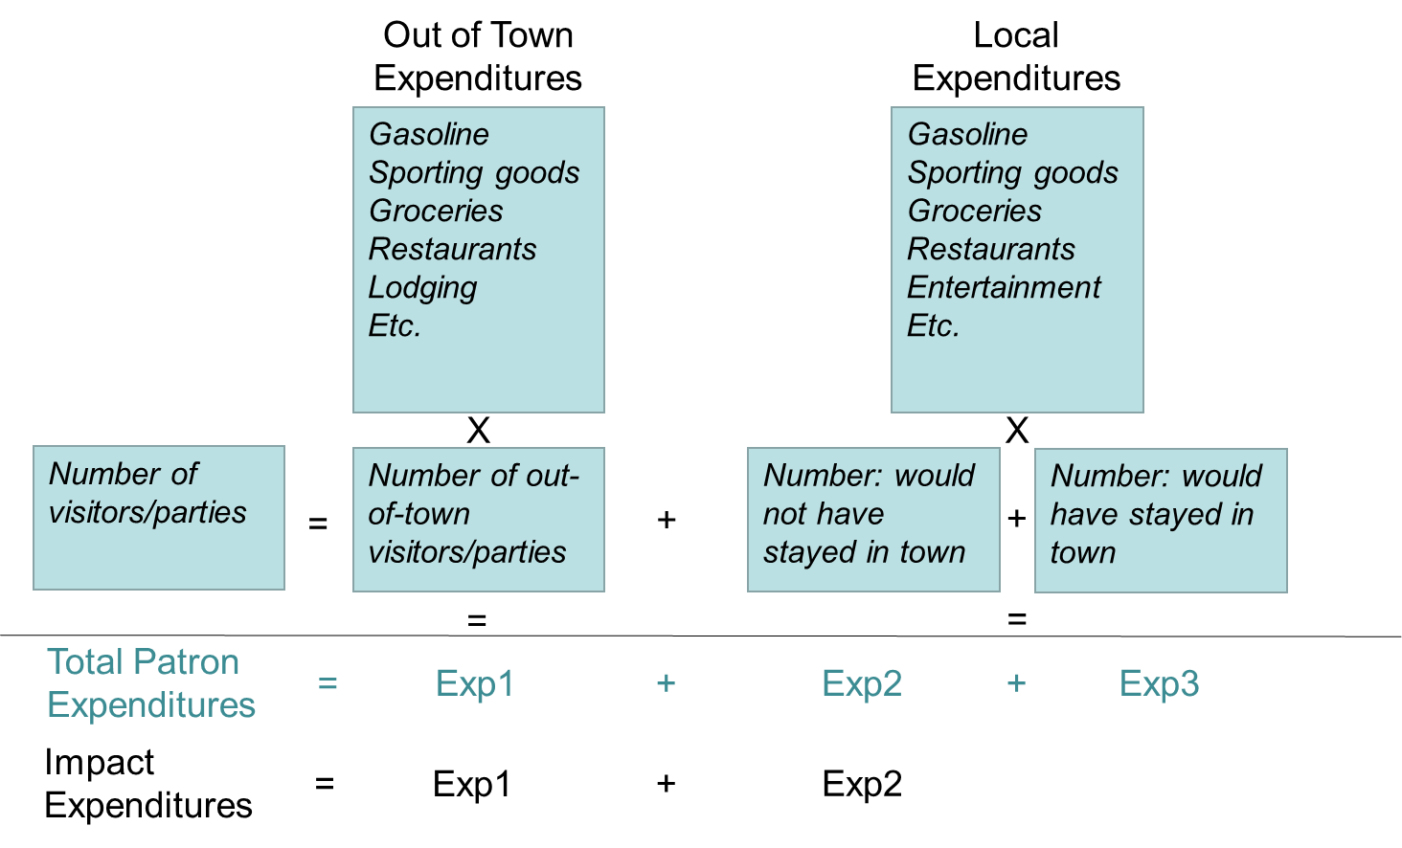
Calculating Direct Impacts of Patron Expenditures

Slide 26
Calculating Direct Impacts of Vendor Expenditures
Vendor impacts are two-part
  For out-of-town vendors:
  For local vendors:
Direct impact of vendor purchases | = | Total vendor purchases
Direct impact of vendor sales | = | 0
Direct impact of vendor purchases | = | 0
Direct impact of vendor sales | = | Total vendor sales
Notes:
Splitting hotel bill into three persons
Families will be better able to tell how much the family spent rather than how much each family member spent
This suggest three measurements necessary for forming an economic impact evaluation of visitors (Stynes 1999),
Estimate the number of tourist patron/parties attending the event
Estimate the average expenditures of tourist patrons/parties
Estimate the multiplier that reflects the secondary impacts of patron expenditures

Slide 27
The Resulting Outcomes
Should have expenditures by category
 | Hosting Exp. | Patron Exp. | Vender Exp. | Vendor Sales | Totals
Hosting Svc. | X |  |  |  | XX
Entertainment | X |  |  |  | XX
Gas |  | X | X |  | XX
Groceries |  | X | X |  | XX
Lodging |  | X | X |  | XX
Restaurants |  | X | X |  | XX
On-venue spending |  | X | X |  | XX
Earnings |  |  |  | X | XX
….
Totals | XX | XX | XX | XX | XX

Slide 28
Nature of Economic Impact Estimates
Three components make up a standard economic impact estimate
  Direct Expenditures – Direct Infusion into local economy
  Indirect Expenditures – B2B transactions to support direct infusion
  Induced Expenditures – Household expenditures from changes in earnings
Minimum requirement for estimating economic impacts
Advanced methods requiring modeling from an economist
Modeling the indirect and induced expenditures
Mostly undertaken by a third party (consultant or higher education)
Notes:
For most purposes, Direct Expenditure impacts are sufficient in estimating the value of a community event
Measuring Indirect and Induced effects requires modeling the direct effects in a standard economic impact model

Slide 29
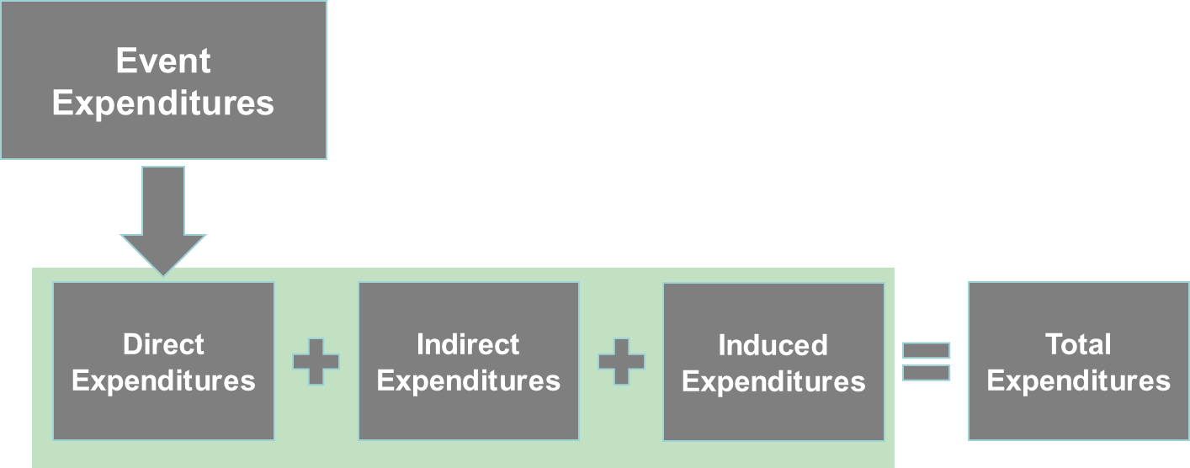
Some Background on Economic Impact Modeling
Economic impact models are standardized
  Mainstream tools of economists for decades
  Well established and rigorously studied
  Traces related expenditures through their conclusions as dollars are recirculated throughout the economy

Slide 30
Total Impact
Is simply the sum of the three component impacts
In practice, the total impact is calculated as a multiple of the direct impact

Slide 31

Questions?
The Center for Economic Analysis
  www.cea.msu.edu/

Slide 32
Economic Multipliers
The larger the local economy, the larger the multiplier
Some industries have larger multipliers than others
Generally generated by computer models
  RIMS II: Bureau of Economic Analysis
  IMPLAN Pro: Minnesota IMPLAN Group
  MITEIM: Daniel J. Stynes, MSU
  EMSI: Economic Models Inc.
  Expert Judgment: Any expert near you

Slide 33
Administering and Writing Surveys
Michigan Tourism Spending and Economic Impact Model (MITEIM) has the following spending categories
Motel, hotel cabin or B&B
Camping fees
Restaurants & bars
Groceries, take-out food/drinks
Gas & oil
Other vehicle expenses
    Local transportation
    Admissions & fees
    Clothing
    Sporting goods
    Gambling
    Souvenirs and other expenses

Slide 34
Selecting Sample Size
First estimate the variance of spending by visit, if one is not already known.
Then estimate the total number of samples needed to be within a range or tolerance.
Notes:
Assume that we must estimate our variance. Using the expectation that the typical visit will result in $100 to $200 community expenditures, will provide an expected variance of $625
If we want to be accurate to within $10 of our estimate, we need 25 completed tourist surveys.
If 25 percent of visitors are expected to be tourist, we will need 100 completed surveys to get 25 completed tourist surveys.

Slide 35
Selecting Sample Size
First estimate the variance of spending by visit, if one is not already known.
Then estimate the total number of samples needed to be within a range or tolerance.
Since we are only using tourist spending to form direct impacts we need 25 completed tourist surveys. If we expect 1 out of ever 4 visits to be tourists, will need 100 completed surveys to get 25 completed tourist surveys.
Notes:
Assume that we must estimate our variance. Using the expectation that the typical visit will result in $100 to $200 community expenditures, will provide an expected variance of $625
If we want to be accurate to within $10 of our estimate, we need 25 completed tourist surveys.
If 25 percent of visitors are expected to be tourist, we will need 100 completed surveys to get 25 completed tourist surveys.

Slide 36
Some Background on Economic Impact Modeling
Because the models are standardized, the limiting factor is how one measures the direct infusion
  The model does all the rest
Best direct infusion measures account for
  All changes – both increases and decreases
Notes:
Give Farmers market example

