Slide 1
Livestock Gross Margin Insurance for Dairy
January & February 2012
Dr. Craig Thomas, MSU-Extension Educator
Genesee, Huron, Lapeer, Macomb, Oakland, St. Clair, Sanilac, Tuscola Counties

Slide 2
2012 Dairy Market Synopsis
2012 Class III futures prices: $16.89 (+$2.48 vs. 2011)
  First half: $17.10 (+$3.52 vs. 2011)
  Second half: $16.69 (+$1.46 vs. 2011)
Commercial disappearance: +3.5% (+242% vs. trend)
  Very strong export market (CY-10 12.8% of U.S. milk production)
  How will exports perform in 2012? USDA says -7.5% vs. 2011
U.S. milk output: +2.7% last seven months (+175% vs. trend)
  Cow numbers: 9.136 M (up 5K since July despite 34K CWT herd rtmt)
  Milk per cow: +3.0% since March 2011
2012 Outlook: there will be pressure to increase milk production with higher milk prices.
  Higher feed costs (~+31% vs. last year)
  Credit situation easing for most farms
  Cow numbers likely to increase and milk per cow to remain above trend

Slide 3
“Prediction is very
difficult, especially if it
is about the future.”
-Neils Bohr

Slide 4
Never underestimate the ability of U.S. dairy farmers to produce milk when determined to do so…despite what obstacles CW say are in the way!
Market Milk
Market Feed

Slide 5
Ag Market Update Meetings
Meet 8 times per year (no meeting in Apr, Jul, Sep, Nov).
Meet in Sandusky and St. Johns
Meet from 10 AM till noon
Outlook and strategies for all major ag markets (corn, soy, wheat, feeds, dairy, beef, energy, etc.)
First meeting free; fees for regular attendance
Jim Hilker, MSU-Extension Specialist
Craig Thomas, MSU-Extension Educator

Slide 6
Is It Worth Your Time?
This is real! 2009
1,530 cow dairy
83 lbs/cow per day (~27,400 lbs/year)
Primary marketing tool: forward contracts
Marketed 38.4% of total milk production
Marketing high: $17.44; low: $14.88
Marketing average: $16.92

Slide 7
Is It Worth Your Time?
This is real! 2009
2009 U.S. average Class III price: $11.36/cwt
Farm’s 2009 average Class III price: $13.46/cwt
Difference: +$2.10/cwt (+$5.56 on mkt milk)
Effect: +$1.85/cow per day
Effect: +$2,405 for the herd per day
Effect: +$878,000 for the farm that year

Slide 8
Is It Worth Your Time?
Net Effect
Same as if every cow on the farm produced 12 lbs milk per day more at an increase of only 12¢/cwt.

Slide 9
Cumulative Probability
Class III Price 1995-Present

Slide 10
Class III Price 1995-Present
Beware of
price
anchoring!
Dec-98
$17.34
92nd
Jul-07
$21.38
100th
May-04
$20.58
99th
Sep-99
$16.26
87th
Jul-01
$15.98
85th
What do all these peaks have in common?

Slide 11
Class III Price 1995-Present

Slide 12
Class III Futures Prices 2009/2010
6/16/08
2009 Ave.
$20.65
99th+
Percentile
6/16/08
2010 Ave.
$19.81
97th
Percentile

Slide 13
Class III Prices
2011 & 2012
Greed
Hope
Fear

Slide 14
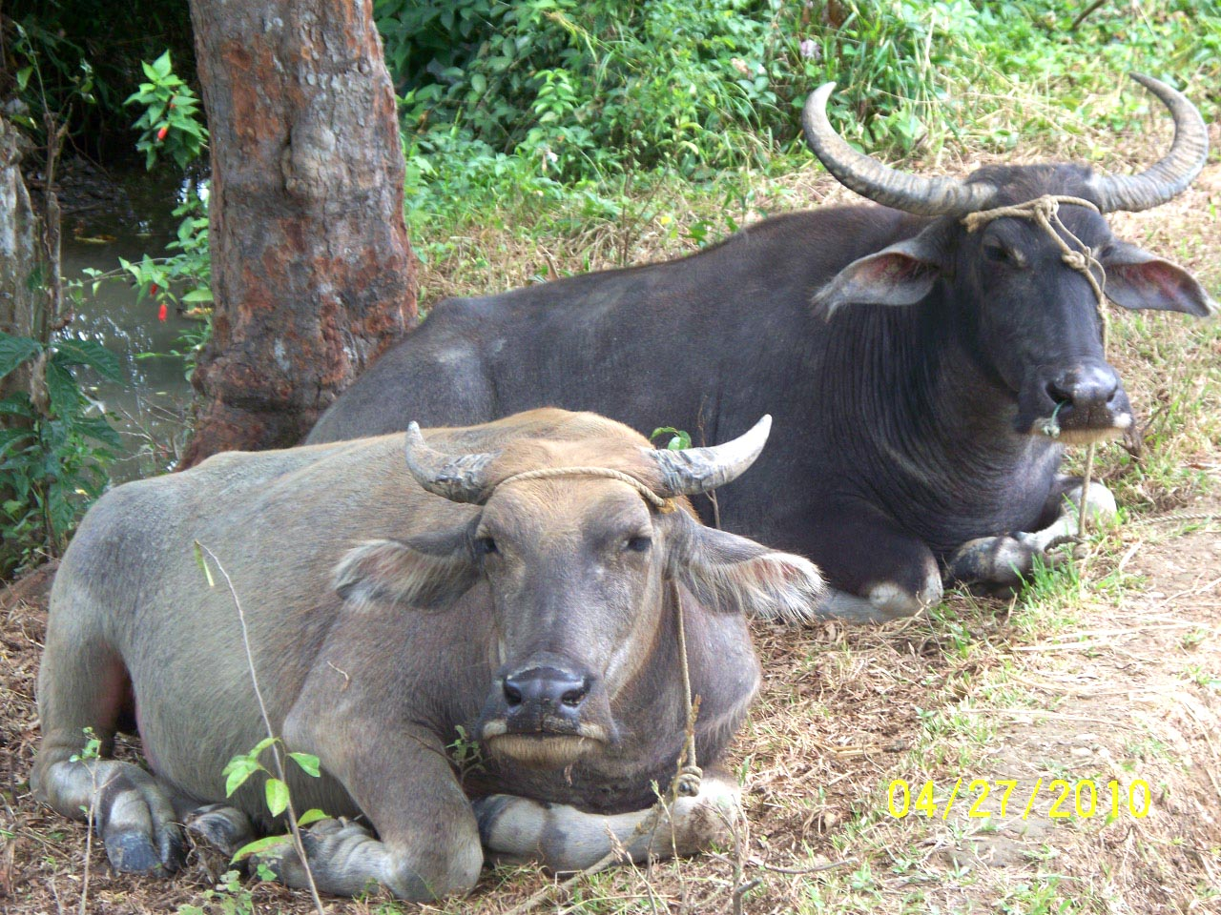
The End

